Slide 1
CAST
Overview, Achievements

Slide 2
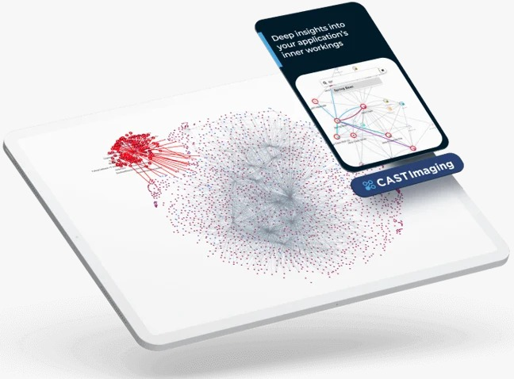




CAST Overview
Overview
CAST is a software intelligence solutions for measuring and improving the quality, security, and performance of software applications
CAST analyzes the source code and architecture of software systems to provide actionable insights and recommendations
CAST helps software teams to deliver better software faster, reduce risks and costs, and increase customer satisfaction

Slide 3
CAST Overview
CAST Imaging (including CAST Dashboards)
A software architecture visualization and analysis tool that helps to understand the structure, dependencies, and interactions of software components
CAST Imaging helps to detect architectural flaws, design violations, and performance bottlenecks that can affect the quality and reliability of software systems
CAST Dashboards provides a holistic view of software health and risks across multiple dimensions, such as robustness, efficiency, security, changeability, and transferability
CAST Dashboards provides detailed diagnostics and remediation guidance to help software teams fix issues and optimize code
CAST Highlight
Provides a comprehensive and granular evaluation of the cloud suitability and effort of applications, based on multiple dimensions and criteria, and supports various cloud platforms and providers
Identifies open-source risks across the entire portfolio and prioritizes the most critical vulnerabilities to address first
Reduce legal risks by detecting all licenses in use across components at portfolio and application level
Get insights on hidden risks due to open-source vulnerability and license risks in dependent components

Slide 4
Achievements
CAST Imaging
Active in 36 accounts (out of 69) covering 462 active apps (out of 653) as of Feb’24
Use cases implemented – Mainframe modernization architecture discovery, Cloud Migration assessment, Technical Debt reduction, Transition, Application Health improvement, Green coding insights etc.
Case studies created for 6 accounts this year
ROI calculation is in progress
CAST Highlight
364 apps onboarded till 25Mar24
Use cases implemented – Open-source components security vulnerabilities and license risks (SCA), Cloud Readiness assessment, Application portfolio rationalization for M&A
Case studies created for 4 accounts this year
General
CAST Assessment integration with DevSecOps pipeline for Azure ADO, Jenkins completed for 5+ accounts
CAST Day completed successfully on 22Nov. 30+ new accounts interactions done through booths and interactive sessions. 2 case studies presented during the event
CAST Webinars on CAST Product Overview, CAST Highlight Overview, CAST Imaging Overview, CAST Dashboard Overview completed
CAST Day in Chennai planned on 02Apr
15+ new accounts in pipeline under proposal, dicsusisons

Slide 5
Thank you

